Slide 1
Kick Start
Complete the 3 question Kick Start independently at your seat
You will have 4 Minutes to complete this assignment
Please begin immediately
Independent work- No talking

Slide 2
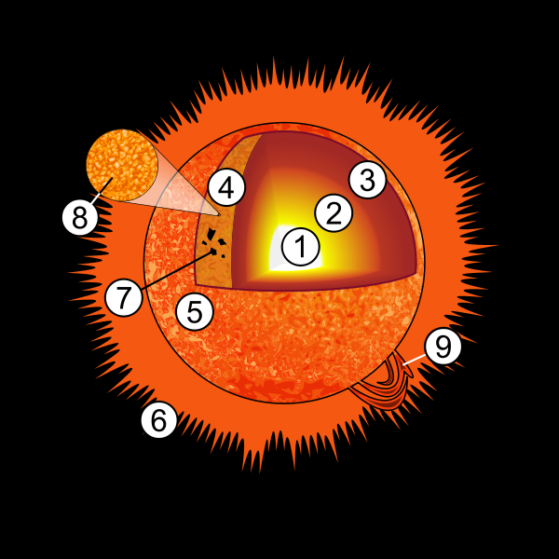
Kick Start
Question 1:
  B: Core
Question 2:
  C: Corona
Question 3:
  1: Core
  2: Radiation Zone
  3: Convection Zone
  4: Photosphere
  5: Chromosphere
  6: Corona

Slide 3
Features of the Sun
Sunspots
Solar Flares
Prominences

Slide 4
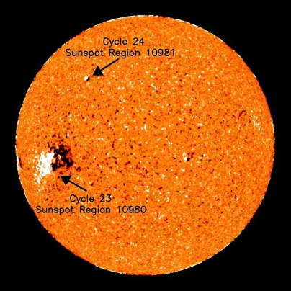
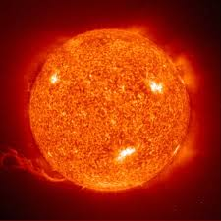
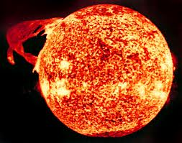
Features of the Sun
They are all at the surface of the Sun
  The Photosphere
Sunspot: Solar Flare:
Prominence:

Slide 5
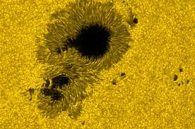
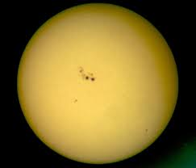
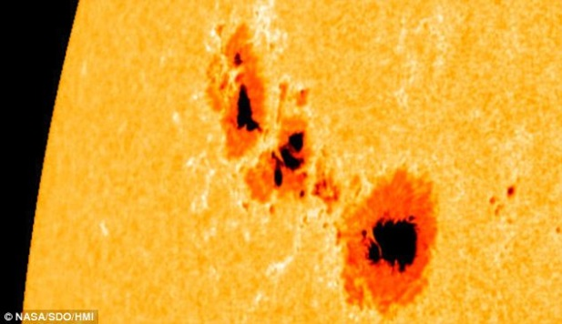
Sunspots
They are found on the Photosphere
Due to the difference in temperature
  Caused by convection currents
Usually go in an 11 year activity cycle
Appear dark because of the temperature difference
A cooler than the rest of the surface

Slide 6
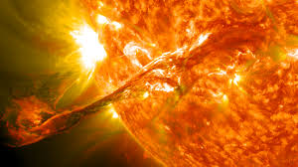
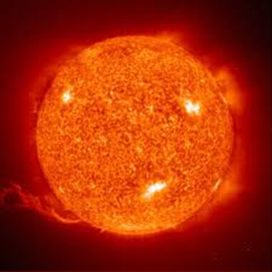
Solar Flare
They exit out of the Photosphere
Release of radiation from the Sun’s surface
Explodes directly outward from the Sun
Causes Solar wind
  A Burst of radiation that is invisible and travels outward from the Sun
Happens due to a weak area in the Sun’s magnetic field on the surface that “break” for an instance and allows radiation to come through

Slide 7

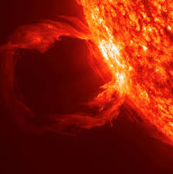
Prominence
They are found on the Photosphere
Loops of gas that exit the Sun and are pulled back into the Sun
Huge! The largest record prominence was over 500,000 miles high
Prominence= LOOP!
Solar Flare= Straight

Slide 8
Features of the Sun
Sunspot: Solar Flare:
Prominence:

Slide 9
Pictures:
Layers of the Sun:
  Solarsystemcentral.com
Sunspots:
  Space.com
  Sciedu.ucar.edu
Solar Flare:
  Bobthealien.co.uk
  En.wikipedia.org
Prominence:
  Soundofheart.org
  Spaceweather.sflorg.com

Slide 10
Resources for Information:
http://www.solarsystemcentral.com/sun_page.html
https://www.windows2universe.org/sun/sun.html

